Slide 1
TOK Assessments

Slide 2
TOK Assessments
Internal Assessment:
Exhibition - 950 Words
Student choose one of the 35 IA prompts (questions)
Select 3 objects and write a commentary of 950 words
Student exhibition their commentary
External Assessment:
Essay - 1600 words
Student select on Essay Title from six titles given by IB
Students write an essay comparing two areas of knowledge in relation to the essay title.

Slide 3
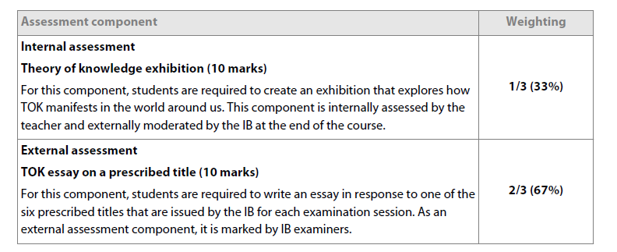
Assessment
Notes:
Madhulika

Slide 4
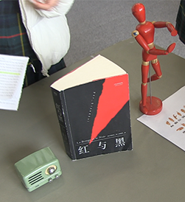
TOK Exhibition (Internal Assessment)
The basic aim of TOK Exhibition is to show how TOK manifests in the real world
Student select one of the 35 IA Prompts (knowledge questions)
They select three objects that connect the selected IA prompt
They write a commentary of 950 words
The Exhibit their objects and commentary.
It is always better if students can choose objects that they have experience in the subjects they study.

Slide 5
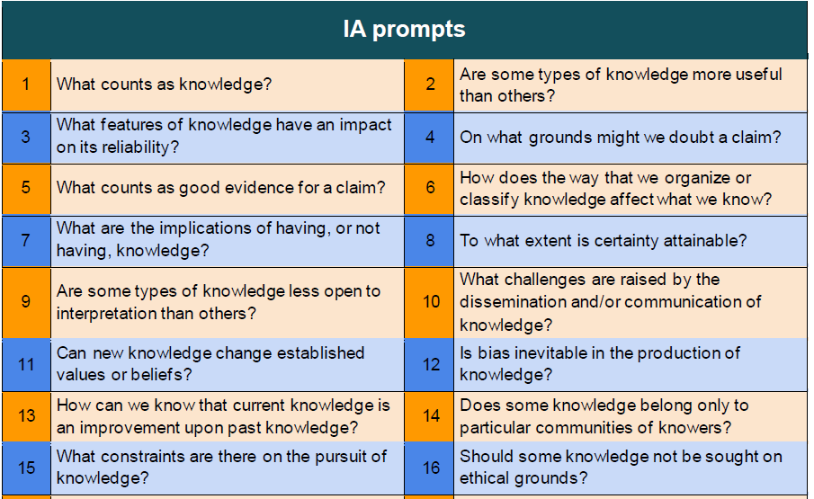

Slide 6
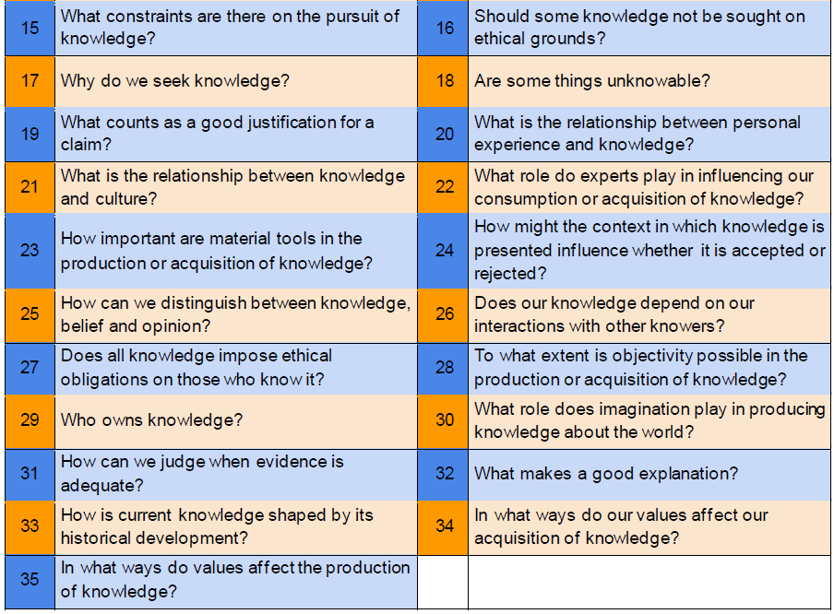

Slide 7
TOK Essay - External Assessment
Students get six essay titles (knowledge questions) from IB on 1st September - DP 2
They select one essay title and write an essay of 1600 words.
The essay title asks students to compare and contrast two areas of knowledge in the essay.
DP Subject teachers can help student formulate relevant arguments and find examples from their subjects
Students who use examples from their DP subjects are more likely to score higher in their Essays.

Slide 8
TOK Essay Title for May 2022 session
Can there be knowledge that is independent of culture? Discuss with reference to mathematics and one other area of knowledge.
To what extent do you agree with the claim that “there’s a world of difference between truth and facts” (Maya Angelou)? Answer with reference to two areas of knowledge.
Is there solid justification for regarding knowledge in the natural sciences more highly than knowledge in another area of knowledge? Discuss with reference to the natural sciences and one other area of knowledge.
How do historians and human scientists give knowledge meaning through the telling of stories? Discuss with reference to history and the human sciences.
How can we distinguish between good and bad interpretations? Discuss with reference to the arts and one other area of knowledge.
If we conclude that there is some knowledge we should not pursue on ethical grounds, how can we determine the boundaries of acceptable investigation within an area of knowledge? Discuss with reference to two areas of knowledge.

